Slide 1

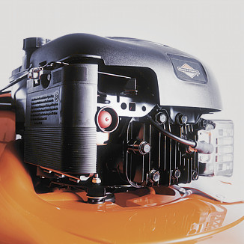

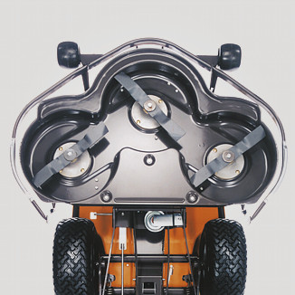
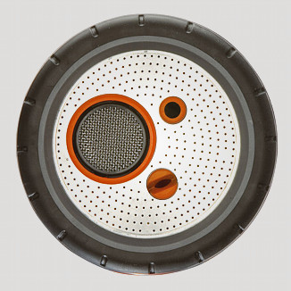
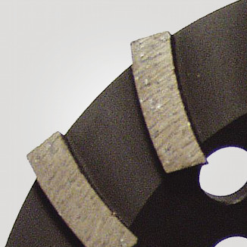
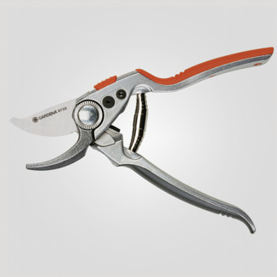
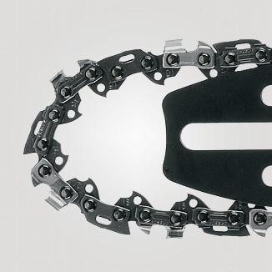
Definition of the KPI Return rate

Slide 2
Purpose
This document defines the KPI return rate for suppliers of direct material. The purpose is to measure our supplier performance of delivering conforming material into our factories.
The KPI measures the amount of nonconformance direct material that we detect in our factories in relationship to the amount of volume of received direct material. Nonconforming direct material does not conform to the drawing, specifications and/or agreed upon standards.
Quantities will be reported in the units of measure in which they are purchased. This applies to production parts / saleable units.

Slide 3

Terminology 1
Supplier
On Transit
Return
Released
Received
Stock/Line
Quantity
OK
Reworked
Released
Factory
In comming
inspection
Blocked material
Suspected
Checked /
Sorted OK
R
E
L
E
A
S
E
D
Reworked
In house, vendor or
3rd party
Sorted NOK
Scrapped
Return

Slide 4
Terminology 2
Received: Direct material that has been registerd in a Husqvarna factory system as received.
Blocked: Direct material that are under evaluation and therefore restricted material. Has a status ”Not available” in the system.
Checked / Sorted OK: Suspected material that has been sorted and/or confirmed to be ok. Has a status ”Available” in the system.
Sorted NOK: Suspected material that has been sorted and confirmed to be nonconforming material
Scrapped: Sorted NOK material that the supplier has decided to scrap
Rework: Sorted NOK material that the supplier and Husqvarna has agreed to rework.
Returned: Sorted NOK material that Husqvarna has agreed to return.
Released: Blocked direct material that has been analyzed and placed in any of the catagories, Sorted OK, Scrapped, Reworked or Returned. The physical parts are no longer in the restricted area.

Slide 5
Calculation
SORTED NOK
Return rate =
1 000 000 *
Received

Slide 6
Method
When a Husqvarna factory identifies suspected material they should immediately remove the batch of physical parts, and the parts in the system, into a restricted material area.
In normal case all sorting of suspected material should be handled by the supplier. The suppliers should be asked if they want to have the batch delivered back to them or if they want to have it delivered to a 3rd party sorting company. If there is a critical need to sort the suspected material, it could be done by Husqvarna.
If Husqvarna or the suppliers sorts the complete batch at a Husqvarna site – then only the actual nonconforming parts will have the status ”Sorted NOK”.
If the supplier takes back the complete batch – then the complete batch will get the status ”Sorted NOK”.
If the supplier sort at Husqvarna site or sends the batch to a 3rd part sorting company – then only the actual nonconforming parts will have the status ”Sorted NOK” if the ”Sorted NOK” parts are identified and available within 10 working days.

Slide 7
Nonconformance vs Conformance
Nonconformance | Conformance
Parts which do not meet drawing specifications or dimensional, functional, or appearance standards as called out in the specifications. | Parts that meet all drawing specifications but are not useable .
Out-of-spec parts that require rework/repair in order to be used. | Parts that meet all specifications and/or standards but have been claimed by a Husqvarna customer/end user.
Parts damaged from inadequate packaging or transportation for which the supplier is responsible. | Parts not released and approved for production and/or have no released drawing (i.e. launch parts, sample/trial parts, DOE parts, pre-productions parts, etc.). Parts that are outside the production system will be addressed through prototype quality measures.
Interim approved PPAP with any defects outside of the boundaries defined by the deviation. | Parts that have an approved deviation for an out-of-spec condition cannot be assigned PPM for rejects associated with the deviated characteristic.
Shipments that are received with mixed parts Parts that are the wrong revision level after the break point has been established. Shipments received where the lable on hte box does not match with the parts inside the box. | Delivery errors, Quantity errors ( to few – too many ) This is delivery deviation

Slide 8
How to handle different cases in the systems?
Case | Status in the system | Return rate status
1. A factory places a batch of material in stock. | Available | Received
2 a. A factory places a batch of received material in incoming inspection area | Blocked – Not available | Received
2 b. Incomming inspection checked the received material and found no defects | Available | Received
3 a. Nonconforming material is identified in stock or at the line. Batch of material is placed in the area for blocked material. | Blocked – Not available | Received
3 b. Supplier doesn’t want to send the batch to a third party. Factory sends back the batch to the supplier | Returned | 100% Received , 100% Returned
4 a. Batch of blocked material is sent to 3rd party for sorting | Blocked – Not available | Received
4 b1. A 3rd party sorted out 70% conformance parts, which were sent back to the factory, and 30% nonconformance parts which were scrapped after agreement with the supplier. | 70% Available 30 % Returned | 100% Received 30 % Returned
4 b2. A 3rd party sorted out 30% nonconforming parts and reworked the parts to be conforming parts and send them back to the factory. | 100 % Available | 100% Received 30 % Returned
5. Supplier delivers nonconforming material, but after risk evaluation a decision is taken to use it anyway. | 100 % Available | 100% Received , 100% Returned
6. A batch is returned to a supplier as nonconforming material – supplier proofs it according to specification. We did a mistake - the supplier delivered correct material. | Not available | Adjust 100% returned to 0% returned for the batch.

Slide 9
Direct material vs Indirect material – packaging material
Direct material | Indirect material
Parts that has a Husqvarna specification/drawing, is part of a product BOM and are sourced by commodity purchasing. | Material that does not have a Husqvarna specification/drawing and/or is not part of a product BOM. Material that are purchased by the local factory organisation.
Example: Labels Packaging boxes Grease or chemicals that are part of the product BOM Service parts that are included inside the packaging box | Example: Tape and staples for the packaging box Grease or chemicals that are not part of the product BOM Material that are used to support the assambly/packaging process, but is not part of the product BOM.

